Slide 1
Mobile development

Slide 2


Introduction
Mobile app development: Creating software for smartphones & tablets (Android and iOS).
Preinstalled or downloaded from app stores.
Growing demand in retail, healthcare, insurance, and more.
Mobile devices as the primary internet connection.
Organizations need responsive mobile apps to meet customer and employee demands.

Slide 3




Android Overview :
Preferred choice for many app development teams.
Android app development : introduced with the snake game on Nov 12,2007
IOS Overview :
Ios : smaller device ecosystem but higher user satisfaction :
Ios apps have fewer devices to support
Users generally have a higher performance for ios apps
Ios app development :
First released on Jun 29,2007, with the game Remote

Slide 4



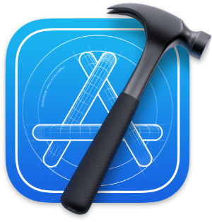

Differences Between Android and iOS Development Languages - Android: Primarily Java and Kotlin. - iOS: Mainly Swift and Objective-C. Tools - Android : android studio - IOS : Xcode App Stories - Android : Google play store - IOS : Apple app store User Demographics - Android : Wider user base, diverse demographics. - IOS : Generally higher-income users, more engaged with apps.

Slide 5

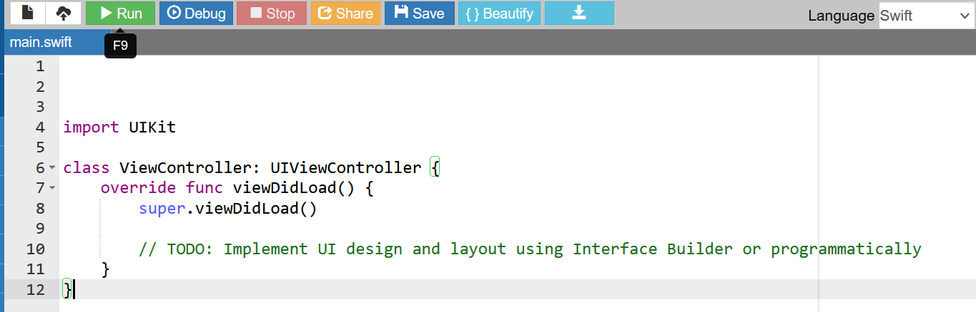
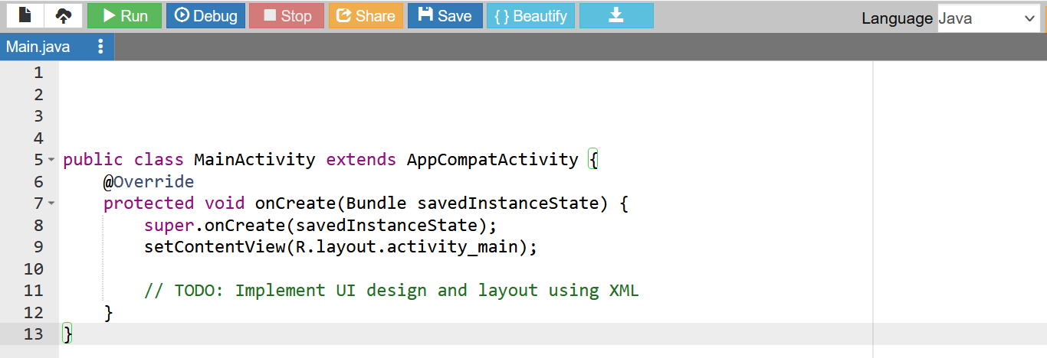
App Development Process (Android and iOS) Design Phase: Define app concept, user personas, and user experience (UX) requirements. Create wireframes and prototypes to visualize app structure and navigation. Design the user interface (UI) elements, including layouts, colors, and typography.
Development Phase
Android: Choose development languages (Java or Kotlin) and IDE (Android Studio). Write code to implement app functionality, using APIs and libraries as needed. Test the app on emulators or physical devices to ensure compatibility. iOS: Select development languages (Swift or Objective-C) and IDE (Xcode). Write code to implement app features, utilizing available frameworks. Test the app on simulators or physical devices to ensure functionality.
For IOS
For android

Slide 6

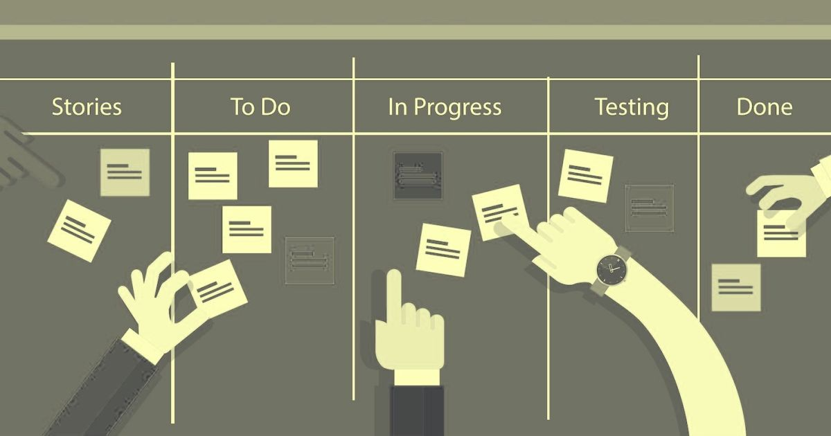

Testing and Refinement:
Perform various testing methods, including functional, UI, and compatibility testing.
Gather feedback from beta testers and address any identified issues.
Continuously iterate, refine, and improve the app based on user feedback and testing results.

Slide 7
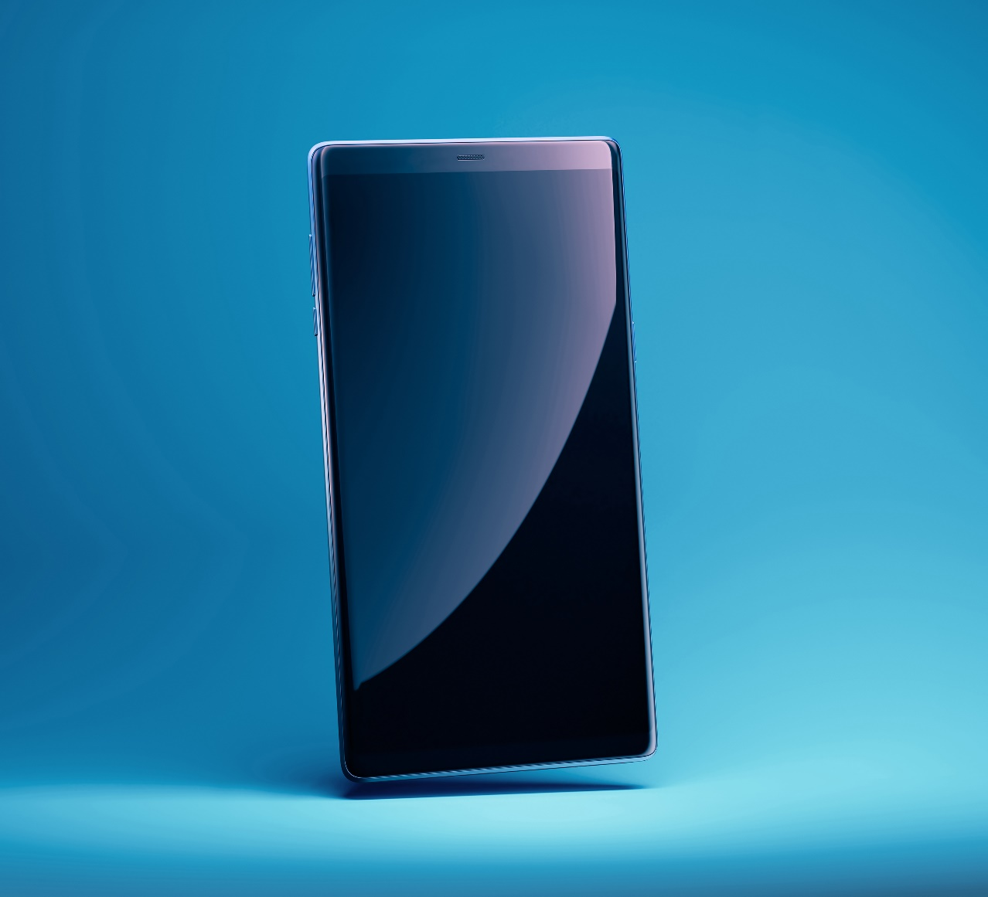
Deployment
Android:
Generate a signed APK (Android Package) file.
Submit the app to the Google Play Store for review and approval.
Once approved, the app becomes available for download and installation.
iOS:
Create an app distribution provisioning profile.
Submit the app to the Apple App Store for review and approval.
Upon approval, the app is published in the App Store for users to download.

Slide 8


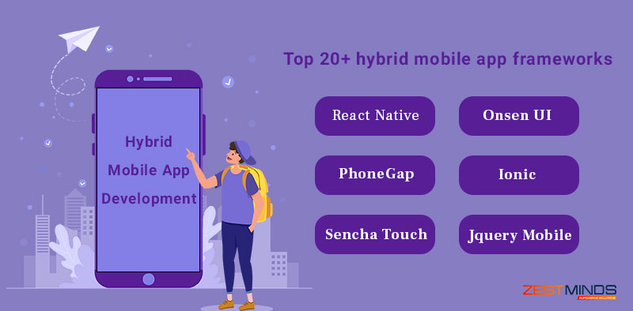
Cross-Platform Development
Introduction:
Cross-platform development enables creating apps that can run on multiple platforms with shared codebase.
Provides cost and time efficiency by reducing the need for separate development for each platform.
Hybrid Frameworks:
Use web technologies (HTML, CSS, JavaScript) to build cross-platform apps.
Examples: Apache Cordova, React Native, Ionic.
Offers a single codebase that runs on multiple platforms.
May have limitations in accessing native device features or performance compared to native apps.

Slide 9

Native Apps with Shared Code:
Develop separate native apps for each platform (Android and iOS) but share a common codebase for core functionality.
Examples: Xamarin, Flutter, React Native (can also be used for hybrid development).
Provides access to native APIs and performance benefits.
Allows platform-specific customization while sharing business logic and UI across platforms.

Slide 10

Considerations for Cross-Platform Development:
App Complexity: Evaluate the complexity and requirements of the app to choose the appropriate development approach.
Native Experience: Consider the need for platform-specific UI/UX and access to native device features.
Development Team Skills: Assess the team's proficiency in programming languages and frameworks.
Time and Budget Constraints: Determine the project timeline and budget for selecting the most suitable cross-platform development option.

Slide 11

Aya Gamal
Dalia Tarek
Hanen Mahmoud
Dina Ahmed

Slide 12

Thanks

